Slide 1



המחלקה למדעי המחשב
Academy award winning films
Data mining and machine learning final project
Eden Moyal

Slide 2
A little background
The Academy Awards:
The Academy Awards, popularly known as the Oscars, are awards for artistic and technical merit in the film industry. They are regarded as one of the most significant and prestigious awards in the entertainment industry. Given annually by the Academy of Motion Picture Arts and Sciences (AMPAS), the awards are an international recognition of excellence in cinematic achievements, as assessed by the Academy's voting membership. The various category winners are awarded a copy of a golden statuette as a trophy, officially called the "Academy Award of Merit", although more commonly referred to by its nickname, the "Oscar".

Slide 3

My research – intro
Research questions:
❖ Can we predict if a film will win an Oscar award and in which category?
❖ What pattern can we expect and what conclusions can we learn? (according to the data)

Slide 4

Data sources
Data set:
❖ CVS from Kaggle

Slide 5

Data cleaning
Data cleaning:
❖ Removing duplicates and empty values.
❖ Replacing missing values.
❖Outliers handling.
Due to the use of a pre-made dataset, all cleaning functions
are used for testing purposes.

Slide 6
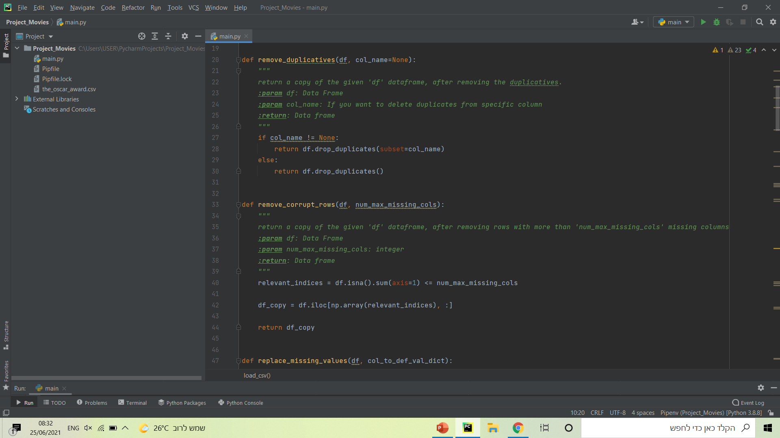
Data cleaning
Removing duplicates and empty values:
Removing duplicates from all the columns.
Removing empty values from each column with
more than 2 empty values.

Slide 7
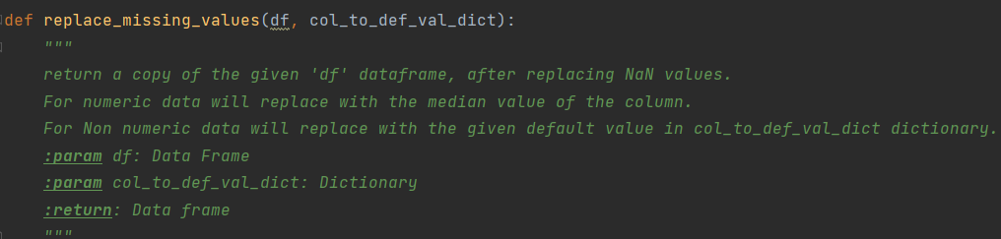
Data cleaning
Replacing missing values:
Replacing values from all the columns – For numeric columns we will replace to the median value of the column, and for Non-numeric to a predefined value.

Slide 8
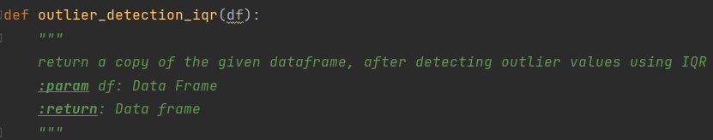
Data cleaning
Outliers handling:
Using the Interquartile Rule to Find Outliers (IQR)

Slide 9
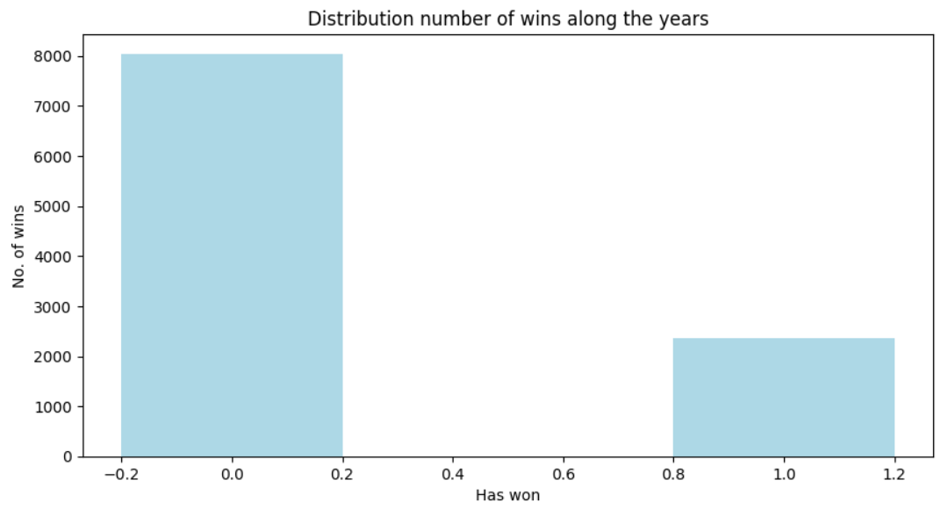
EDA
Distribution number of wins along the years:
Kind: bar plot
Conclusion: over the years there were less wins.
From the graph we can see there is only 20% chance of winning.

Slide 10
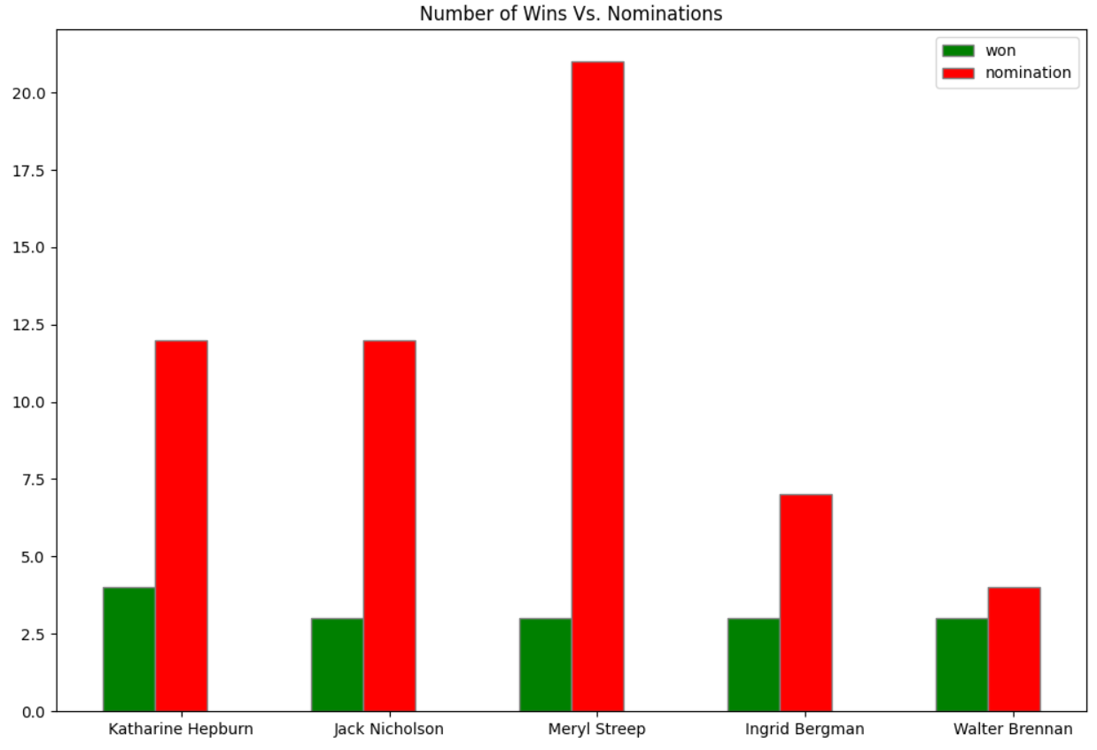
EDA
Number of Wins Vs. Nominations:
For actors and actresses with more than 2 wins
Kind: multiple bar plots
Conclusion: there is a dissonance between the number of nominations and wins for actors and actresses.
Key values: Number of wins over the years in green
Number of Nominations over the years in red

Slide 11
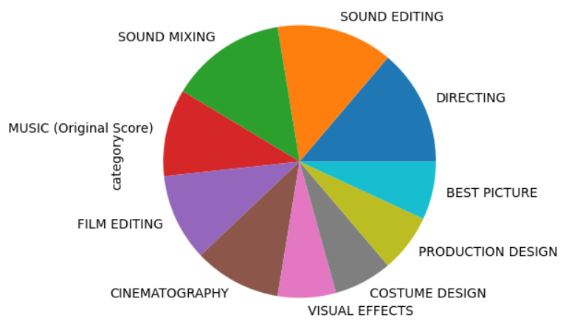
EDA
Number of Wins per category:
For movies with more than 5 wins between 2010-2020
Kind: pie plot
Conclusion: movies with a lot of awards, win mostly in the music and sound categories. Chances of winning may increase for a good music and sound editing.

Slide 12

Machine Learning
Machine Learning:
Using the below algorithms:
❖ Logistic regression
❖ Decision tree

Slide 13
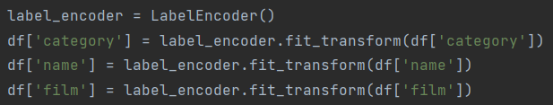

Machine Learning
Machine Learning:
Before building the models - changing all the columns to numeric.
❖ Encoding all nonnumeric columns to numbers:
❖ Replacing true values to ‘1’ and false values to ‘0’ in the column “winner”:

Slide 14
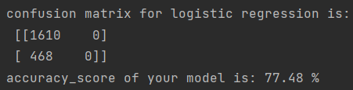
ML – logistic regression
Logistic regression predicts the values of categorical variables.
Using `sklearn` library and logistic regression I was able to train a model that predicts if a film will win an Oscar award.
The model predicted in accuracy of ~78%.

Slide 15
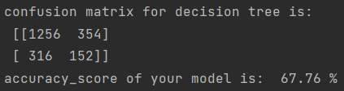
ML – decision tree
Using `sklearn` library and `tree` I was able to train a model that predicts in which category a film will win an Oscar award.
The model predicted in accuracy of ~68%.
A relatively small number of properties will create a simple and ideal model using a decision tree.

Slide 16


Thanks for watching
See you in the movies

